Slide 1
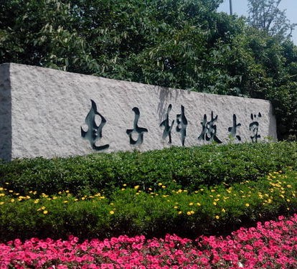

挑战杯
电子科大商业计划书
汇报人：同学社
Notes:
本PPT模板部分元素使用了幻灯片母版制作。如果需要修改，点击-视图-幻灯片母版-修改；完成后关闭编辑母版即可。

Slide 2
01
文化介绍
双击在此添加你的文本信息内容
02
优势详解
双击在此添加你的文本信息内容
案例展示
03
双击在此添加你的文本信息内容
04
合作共赢
双击在此添加你的文本信息内容
Notes:
本PPT模板部分元素使用了幻灯片母版制作。如果需要修改，点击-视图-幻灯片母版-修改；完成后关闭编辑母版即可。

Slide 3

PART 01
企业文化介绍
Double-click here to add your text message content Double-click here to add your text message content
Notes:
本PPT模板部分元素使用了幻灯片母版制作。如果需要修改，点击-视图-幻灯片母版-修改；完成后关闭编辑母版即可。

Slide 4




01 企业文化介绍
1
2
3
标题文字添加
标题文字添加
标题文字添加
The user can demonstrate on a projector or computer, or presentation and make it film to be ua wider field
The user can demonstrate on a projector or computer, or presentation and make it film to be ua wider field
The user can demonstrate on a projector or computer, or presentation and make it film to be ua wider field

Slide 5
01 企业文化介绍
添加您的标题
添加您的标题
添加您的标题
添加您的标题
添加您的标题
Please replace text, click add relevant headline, modify the text content, also can Please replace text
Please replace text, click add relevant headline, modify the text content, also can Please replace text
Please replace text, click add relevant headline, modify the text content, also can Please replace text
Please replace text, click add relevant headline, modify the text content, also can Please replace text
Please replace text, click add relevant headline, modify the text content, also can Please replace text

Slide 6
01 企业文化介绍
标题文字添加
标题文字添加
The user can demonstrate on a projector or computer, or presentation and make it film to be used in a wider field
The user can demonstrate on a projector or computer, or presentation and make it film to be used in a wider field
标题文字添加
标题文字添加
The user can demonstrate on a projector or computer, or presentation and make it film to be used in a wider field
The user can demonstrate on a projector or computer, or presentation and make it film to be used in a wider field

Slide 7

01 企业文化介绍
YOUR TITLE
Please replace text, click add relevant headline, modify the text content, also can copy your content to Please replace text, click add relevant headline, modify the text content, also can copy your content to Please replace text, click add relevant headline, modify the text content
Ultimate Time
Please replace text, click add relevant headline, modify the text content, also can copy your content to
Ultimate Time
Please replace text, click add relevant headline, modify the text content, also can copy your content to
Ultimate Time
Please replace text, click add relevant headline, modify the text content, also can copy your content to
Ultimate Time
Please replace text, click add relevant headline, modify the text content, also can copy your content to

Slide 8
01 企业文化介绍
添加您的标题
添加您的标题
We have many PowerPoint templates that has been specifically designed to help anyone that is stepping into the world of PowerPoint for the very first time.
We have many PowerPoint templates that has been specifically designed to help anyone that is stepping into the world of PowerPoint for the very first time.
1
3
添加您的标题
添加您的标题
We have many PowerPoint templates that has been specifically designed to help anyone that is stepping into the world of PowerPoint for the very first time.
We have many PowerPoint templates that has been specifically designed to help anyone that is stepping into the world of PowerPoint for the very first time.
2
4
Please replace text, click add relevant headline, modify the text content, also can Please replace text, click add relevant headline, modify the text content, also can Please replace text, click add relevant headline, modify the text content, also can Please

Slide 9
PART 02
产品优势详解
Double-click here to add your text message content Double-click here to add your text message content
Notes:
本PPT模板部分元素使用了幻灯片母版制作。如果需要修改，点击-视图-幻灯片母版-修改；完成后关闭编辑母版即可。

Slide 10
02 产品优势详解
45%
文字添加
文字添加
The user can demonstrate on a projector or computer, or presentation and make it film to be used in a wider field
The user can demonstrate on a projector or computer, or presentation and make it film to be used in a wider field
65%
83%
文字添加
文字添加
78%
The user can demonstrate on a projector or computer, or presentation and make it film to be used in a wider field
The user can demonstrate on a projector or computer, or presentation and make it film to be used in a wider field

Slide 11
02 产品优势详解
添加标题
添加标题
添加标题
添加标题
1
2
3
4
The user can demonstrate on a projector or computer, or presentation and make it film to be used
The user can demonstrate on a projector or computer, or presentation and make it film to be used
The user can demonstrate on a projector or computer, or presentation and make it film to be used
The user can demonstrate on a projector or computer, or presentation and make it film to be used

Slide 12


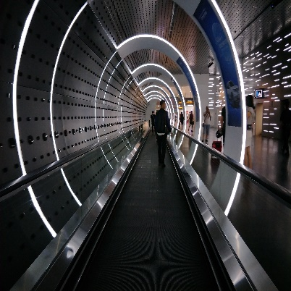
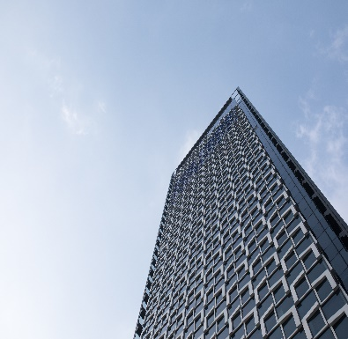
02 产品优势详解
添加标题
添加标题
添加标题
添加标题
and videos on Pixabay and videos on Pixabay
and videos on Pixabay and videos on Pixabay
and videos on Pixabay and videos on Pixabay
and videos on Pixabay and videos on Pixabay

Slide 13
02 产品优势详解
标题文字添加
标题文字添加
The user can demonstrate on a projector or computer, ilm to be used in a wider fiel
The user can demonstrate on a projector or computer, ilm to be used in a wider fiel
标题文字添加
标题文字添加
标题文字添加
The user can demonstrate on a projector or computer, ilm to be used in a wider fiel
The user can demonstrate on a projector or computer, ilm to be used in a wider fiel
The user can demonstrate on a projector or computer, ilm to be used in a wider fiel

Slide 14
PART 03
成功案例展示
Double-click here to add your text message content Double-click here to add your text message content
Notes:
本PPT模板部分元素使用了幻灯片母版制作。如果需要修改，点击-视图-幻灯片母版-修改；完成后关闭编辑母版即可。

Slide 15
03 成功案例展示
标题文字添加
The user can demonstrate on a projector or computer, or presentation and make it film to be used in a wider field
标题文字添加
The user can demonstrate on a projector or computer, or presentation and make it film to be used in a wider field
标题文字添加
The user can demonstrate on a projector or computer, or presentation and make it film to be used in a wider field
标题文字添加
The user can demonstrate on a projector or computer, or presentation and make it film to be used in a wider field

Slide 16
03 成功案例展示
标题文字添加
标题文字添加
print the presentation and make it film to be used in a wider field
print the presentation and make it film to be used in a wider field
标题文字添加
标题文字添加
print the presentation and make it film to be used in a wider field
print the presentation and make it film to be used in a wider field
标题文字添加
标题文字添加
print the presentation and make it film to be used in a wider field
print the presentation and make it film to be used in a wider field

Slide 17
03 成功案例展示
3000
2000
添加您的标题
1500
Please replace text, click add relevant headline, modify the text content, also can Please
1000
500
添加您的标题
Please replace text, click add relevant headline, modify the text content, also can Please
标题
标题
标题
标题
标题

Slide 18
03 成功案例展示
90%
presentation and make it film to be used in a wider field
标题文字添加
70%
presentation and make it film to be used in a wider field
标题文字添加
95%
presentation and make it film to be used in a wider field
标题文字添加
45%
presentation and make it film to be used in a wider field
标题文字添加
75%
presentation and make it film to be used in a wider field
标题文字添加

Slide 19
PART 04
投资合作共赢
Double-click here to add your text message content Double-click here to add your text message content
Notes:
本PPT模板部分元素使用了幻灯片母版制作。如果需要修改，点击-视图-幻灯片母版-修改；完成后关闭编辑母版即可。

Slide 20

04 投资合作共赢
Part 01
标题文字添加这里
Part 02
标题文字添加这里
Part 03
标题文字添加这里
Part 04
标题文字添加这里
添加您的文字内容
The user can demonstrate on a projector or computer, or print the presentation and make it into a film to be used in a wider can demonstrate on a projector or computer, or print the presentation and make it into a film to be used in a wider field

Slide 21
04 投资合作共赢
标题文字添加
标题文字添加
标题文字添加
标题文字添加
标题文字添加
The user can demonstrate on a projector or computer
The user can demonstrate on a projector or computer
The user can demonstrate on a projector or computer
The user can demonstrate on a projector or computer
The user can demonstrate on a projector or computer

Slide 22


04 投资合作共赢
输入标题内容
Please replace text, click add relevant headline, modify the text content, also can Please replace text, click add relevant headline, modify the text content, also can Please replace text,
添加您的标题
Please replace text, click add relevant headline, modify the text content, also can Please replace text, click add relevant headline, modify the text content, also can Please replace text, click add relevant headline, modify the text content, also can Please

Slide 23
04 投资合作共赢
文字添加
文字添加
文字添加
文字添加
文字添加
文字添加
文字添加
The user can demonstrate on a projector or computer, or presentation and make it film to be used in a wider field

Slide 24
挑战杯
电子科大商业计划书
汇报人：同学社
Notes:
本PPT模板部分元素使用了幻灯片母版制作。如果需要修改，点击-视图-幻灯片母版-修改；完成后关闭编辑母版即可。

